Slide 1


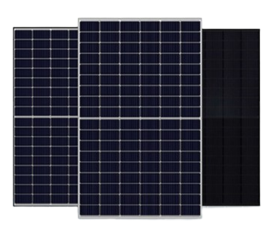









Solar Module Manufacturer & Comprehensive EPC Solution Provider
Manufacturing of Mono PERC Solar PV Modules
(Range 440Watt to 555Watt)
Solar
PV Panel
Solar Pump Controller
Solar Water Pumping System
Solar AC/DC Pumps
Solar Inverter Charger
Solar Charger Controller
Solar Home System
Solar Lighting System
We Offer on :

Slide 2

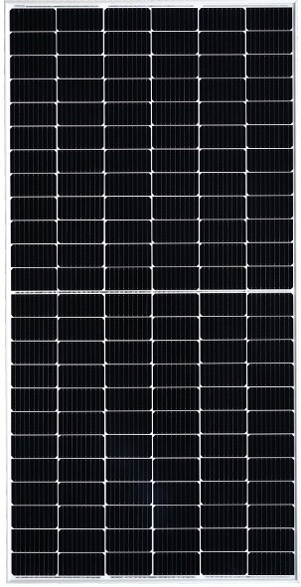



HimSol- 144 Cell
Key Features
High Module Conversion Efﬁciency
Module efﬁciency up to 21.10 % achieved through advanced cell technology and manufacturing process.
Advanced Technology
MBB- Multi Busbar (10BB) / Halfcut MONOPERC cells /Ga Doped Wafers.
Positive Tolerance
Power output with a positive tolerance.
Excellent performance in low light
Superior output in low irradiance Increased power production even in low-light environments.
Extended Wind and Snow load Tests
Certiﬁed to withstand: wind load (2400 Pascal) and snow load (5400 Pascal).
Excellent PID Resistance
Excellent Anti-PID performance and certiﬁed for up-to 288 Hrs
Withstanding a Harsh Environment
Reliable quality leads to better sustainability, even in harsh environments such as deserts,
farms, coastal and the areas with ammonia exposure
Rigorous Testing Criteria
100% I-V Measurement, HiPOT test and EL inspection, ensures defect-free modules
100%
98.00%
80.00%
84.8%
01
05
10
15
20
25

Slide 3
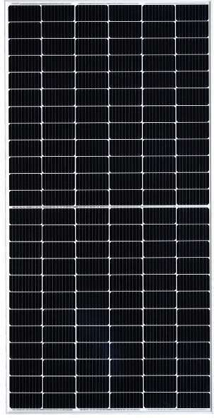
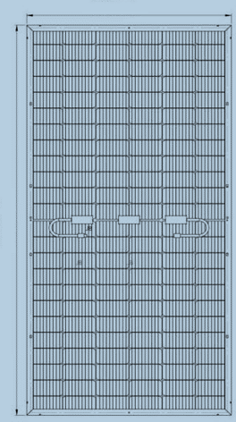
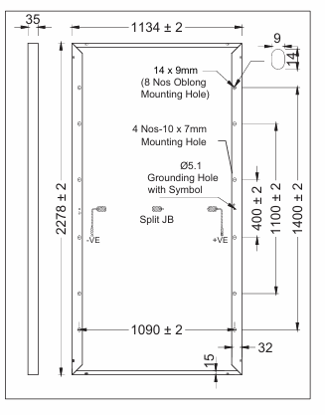
Electrical Data Performance
Module Type |  | 520Wp | 525Wp | 530Wp | 535Wp | 540Wp | 545Wp | 550Wp | 555Wp
Conditions | Unit | STC | STC | STC | STC | STC | STC | STC | STC
Peak Power, Pmax (Wp) | W | 520 | 525 | 530 | 535 | 540 | 545 | 550 | 555
Voltage at Maximum power, Vmp | V | 41.07 | 41.23 | 41.38 | 41.52 | 41.65 | 41.79 | 41.91 | 42.04
Current at maximum power, Imp | A | 12.67 | 12.74 | 12.81 | 12.89 | 12.97 | 13.05 | 13.13 | 13.21
Open circuit voltage, Voc | V | 48.98 | 49.15 | 49.31 | 49.46 | 49.61 | 49.75 | 49.88 | 49.99
Short circuit current, Isc | A | 13.53 | 13.60 | 13.67 | 13.75 | 13.83 | 13.91 | 13.99 | 14.07
Module Efﬁciency (%) |  | 20.13% | 20.32% | 20.52% | 20.71% | 20.90% | 21.10% | 21.29% | 21.48%
Operating Temperature ( 0C) |  |  | -40°C~+85°C | Temperature coefﬁcient of Isc (a) |  | -0.048%/°C
Maximum system voltage |  |  | 1500VDC | Nominal Operating cell temperature (NOCT) |  | 45±2°C
Maximum series fuse rating |  |  | 25A | Fire Safety |  | Class-C
Power tolerance (Wp) |  |  | 0~+3% | Application |  | Class-A
Temperature coefﬁcient of Pmax (γ) |  |  | -0.36%/°C | Safety Class |  | Class-II
Temperature coefﬁcient of Voc (ß) |  |  | -0.28%/°C | Temperature coefﬁcient of Isc (a) |  | -0.046%/°C
STC: Irradiance 1000W/m², module temperature 25°C, AM =1.5; NOCT: Irradiance 800W/m², ambient temperature 20°C, AM=1.5, wind Speed 1m/s. Average power reduction of 4.5% at 200W/m² as per IEC 60904- 1. Except Pmax, all other parameters have tolerance of +/-5%, measurement uncertainty +/-3%
Module Mechanical Data
I-V Characteristics At Different Irradiations
SPECIFICATION DATA
PV module : HimSol- 144Cell”
Cell Technology Mono PERC Crystalline 182 x 91mm – MBB | 144 Cells
Dimensions (LxWxH) 1976 mm X 992 mm X 35 mm
Cells temp. = 25ºC
Weight 28.5 kgs
Incident Irrad. = 1000 W/m²
Superstrate 3.2mm High Transmission, Low Iron, ARC Tempered Glass
Incident Irrad. = 800 W/m²
Back Sheet Multilayered Back Sheet
Frame Silver/ Black Anodized Aluminium
Current (A)
Incident Irrad. = 600 W/m²
Junction Box IP 68, Split Junction Box with Individual Bypass Diodes
Cable & Connectors 4.0mm2, Solar Cable, 300mm, MC4 Compatible/ Connectors
Incident Irrad. = 400 W/m²
Application Class Class A (Safety Class II)
Mechanical Load Test 5400 Pa (Snow load), 2400 Pa (Wind load)
Incident Irrad. = 200 W/m²
Max. Series Fuse Rating 25 A
Per Container.
The speciﬁcations included in this datasheet are subject to change without notice.
The electrical data given here is for reference purpose only.
Please conﬁrm your exact requirements with the sales representative while placing your order.
Refer installation Manual instructions & Himalayan Solar warranty statement for terms & conditions
Voltage (V)

Slide 4
Electrical Data Performance
Module Type |  | 480Wp | 485Wp | 490Wp | 495Wp | 500Wp | 505Wp | 510Wp | 515Wp
Conditions | Unit | STC | STC | STC | STC | STC | STC | STC | STC
Peak Power, Pmax (Wp) | W | 480 | 485 | 490 | 495 | 500 | 505 | 510 | 515
Voltage at Maximum power, Vmp | V | 37.02 | 37.23 | 37.44 | 37.66 | 37.83 | 38.04 | 38.27 | 38.46
Current at maximum power, Imp | A | 12.97 | 13.03 | 13.09 | 13.15 | 13.22 | 13.28 | 13.33 | 13.40
Open circuit voltage, Voc | V | 44.53 | 44.74 | 44.91 | 45.13 | 45.32 | 45.53 | 45.71 | 45.92
Short circuit current, Isc | A | 13.58 | 13.65 | 13.73 | 13.80 | 13.87 | 13.93 | 13.99 | 14.04
Module Efﬁciency (%) |  | 20.21% | 20.42% | 20.64% | 20.85% | 21.06% | 21.27% | 21.48% | 21.69%
Operating Temperature ( 0C) |  |  | -40°C~+85°C | Temperature coefﬁcient of Isc (a) |  | -0.048%/°C
Maximum system voltage |  |  | 1500VDC | Nominal Operating cell temperature (NOCT) |  | 45±2°C
Maximum series fuse rating |  |  | 25A | Fire Safety |  | Class-C
Power tolerance (Wp) |  |  | 0~+3% | Application |  | Class-A
Temperature coefﬁcient of Pmax (γ) |  |  | -0.36%/°C | Safety Class |  | Class-II
Temperature coefﬁcient of Voc (ß) |  |  | -0.28%/°C | Temperature coefﬁcient of Isc (a) |  | -0.046%/°C
STC: Irradiance 1000W/m², module temperature 25°C, AM =1.5; NOCT: Irradiance 800W/m², ambient temperature 20°C, AM=1.5, wind Speed 1m/s. Average power reduction of 4.5% at 200W/m² as per IEC 60904- 1. Except Pmax, all other parameters have tolerance of +/-5%, measurement uncertainty +/-3%
Module Mechanical Data
I-V Characteristics At Different Irradiations
SPECIFICATION DATA
PV module : HimSol- 144Cell”
Cell Technology Mono PERC Crystalline 182 x 91mm – MBB | 144 Cells
Dimensions (LxWxH) 2094 mm X 1134 mm X 35 mm
Cells temp. = 25ºC
Weight 26 kgs
Incident Irrad. = 1000 W/m²
Superstrate 3.2mm High Transmission, Low Iron, ARC Tempered Glass
Incident Irrad. = 800 W/m²
Back Sheet Multilayered Back Sheet
Frame Silver/ Black Anodized Aluminium
Current (A)
Incident Irrad. = 600 W/m²
Junction Box IP 68, Split Junction Box with Individual Bypass Diodes
Cable & Connectors 4.0mm2, Solar Cable, 300mm, MC4 Compatible/ Connectors
Incident Irrad. = 400 W/m²
Application Class Class A (Safety Class II)
Mechanical Load Test 5400 Pa (Snow load), 2400 Pa (Wind load)
Incident Irrad. = 200 W/m²
Max. Series Fuse Rating 25 A
Per Container.
The speciﬁcations included in this datasheet are subject to change without notice.
The electrical data given here is for reference purpose only.
Please conﬁrm your exact requirements with the sales representative while placing your order.
Refer installation Manual instructions & Himalayan Solar warranty statement for terms & conditions
Voltage (V)

Slide 5
Electrical Data Performance
Module Type |  | 440Wp | 445Wp | 450Wp | 455Wp | 460Wp | 465Wp | 470Wp
Conditions | Unit | STC | STC | STC | STC | STC | STC | STC
Peak Power, Pmax (Wp) | W | 440 | 445 | 450 | 455 | 460 | 465 | 470
Voltage at Maximum power, Vmp | V | 33.84 | 34.05 | 34.24 | 34.41 | 34.57 | 34.72 | 34.86
Current at maximum power, Imp | A | 13.01 | 13.07 | 13.15 | 13.23 | 13.31 | 13.40 | 13.49
Open circuit voltage, Voc | V | 41.30 | 41.52 | 41.72 | 41.90 | 42.07 | 42.23 | 42.38
Short circuit current, Isc | A | 13.61 | 13.66 | 13.73 | 13.80 | 13.87 | 13.94 | 14.01
Module Efﬁciency (%) |  | 20.29% | 20.52% | 20.75% | 20.99% | 21.22% | 21.45% | 21.68%
Operating Temperature ( 0C) |  |  | -40°C~+85°C | Temperature coefﬁcient of Isc (a) |  | -0.048%/°C
Maximum system voltage |  |  | 1500VDC | Nominal Operating cell temperature (NOCT) |  | 45±2°C
Maximum series fuse rating |  |  | 25A | Fire Safety |  | Class-C
Power tolerance (Wp) |  |  | 0~+3% | Application |  | Class-A
Temperature coefﬁcient of Pmax (γ) |  |  | -0.36%/°C | Safety Class |  | Class-II
Temperature coefﬁcient of Voc (ß) |  |  | -0.28%/°C | Temperature coefﬁcient of Isc (a) |  | -0.046%/°C
STC: Irradiance 1000W/m², module temperature 25°C, AM =1.5; NOCT: Irradiance 800W/m², ambient temperature 20°C, AM=1.5, wind Speed 1m/s. Average power reduction of 4.5% at 200W/m² as per IEC 60904- 1. Except Pmax, all other parameters have tolerance of +/-5%, measurement uncertainty +/-3%
Module Mechanical Data
I-V Characteristics At Different Irradiations
SPECIFICATION DATA
PV module : HimSol- 120 Cell”
Cell Technology Mono PERC Crystalline 182 x 91mm – MBB | 120 Cells
Dimensions (LxWxH) 1912 mm X 1134 mm X 35 mm
Cells temp. = 25ºC
Weight 24 kgs
Incident Irrad. = 1000 W/m²
Superstrate 3.2mm High Transmission, Low Iron, ARC Tempered Glass
Incident Irrad. = 800 W/m²
Back Sheet White/ Black/ Transparent Backsheet
Frame Silver/ Black Anodized Aluminium
Current (A)
Incident Irrad. = 600 W/m²
Junction Box IP 68, Split Junction Box with Individual Bypass Diodes
Cable & Connectors 4.0mm2, Solar Cable, 300mm, MC4 Compatible/ Connectors
Incident Irrad. = 400 W/m²
Application Class Class A (Safety Class II)
Mechanical Load Test 5400 Pa (Snow load), 2400 Pa (Wind load)
Incident Irrad. = 200 W/m²
Max. Series Fuse Rating 25 A
Per Container.
The speciﬁcations included in this datasheet are subject to change without notice.
The electrical data given here is for reference purpose only.
Please conﬁrm your exact requirements with the sales representative while placing your order.
Refer installation Manual instructions & Himalayan Solar warranty statement for terms & conditions
Voltage (V)

Slide 6
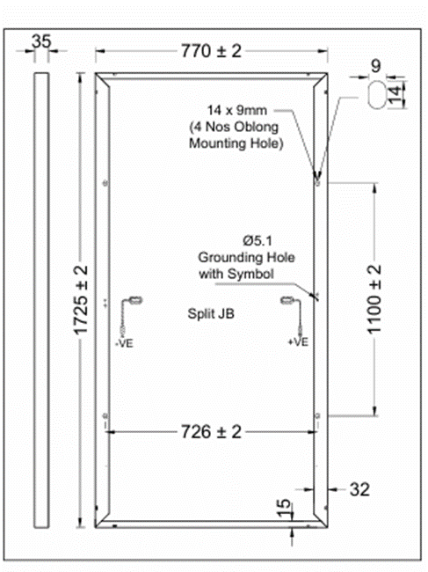
Electrical Data Performance
Module Type |  | 265Wp | 270Wp | 275Wp | 280Wp
Conditions | Unit | STC | STC | STC | STC
Peak Power, Pmax (Wp) | W | 265 | 270 | 275 | 280
Voltage at Maximum power, Vmp | V | 20.69 | 20.83 | 20.95 | 21.12
Current at maximum power, Imp | A | 12.82 | 12.97 | 13.13 | 13.26
Open circuit voltage, Voc | V | 24.65 | 24.80 | 24.94 | 25.04
Short circuit current, Isc | A | 13.67 | 13.83 | 13.99 | 14.08
Module Efﬁciency (%) |  | 19.95% | 20.33% | 20.70% | 21.08%
STC: Irradiance 1000W/m², module temperature 25°C, AM =1.5; NOCT: Irradiance 800W/m², ambient temperature 20°C, AM=1.5, wind Speed 1m/s. Average power reduction of 4.5% at 200W/m² as per IEC 60904- 1. Except Pmax, all other parameters have tolerance of +/-5%, measurement uncertainty +/-3%
Module Mechanical Data
I-V Characteristics At Different Irradiations
SPECIFICATION DATA
PV module : HimSol- 120 Cell”
Cell Technology Mono PERC Crystalline 182 x 91mm – MBB | 72 Cells
Dimensions (LxWxH) 1725 mm X 770 mm X 35 mm
Cells temp. = 25ºC
Weight 14.6 kgs
Incident Irrad. = 1000 W/m²
Superstrate 3.2mm High Transmission, Low Iron, ARC Tempered Glass
Incident Irrad. = 800 W/m²
Back Sheet White/ Black/ Transparent Backsheet
Frame Silver/ Black Anodized Aluminium
Current (A)
Incident Irrad. = 600 W/m²
Junction Box IP 68, Split Junction Box with Individual Bypass Diodes
Incident Irrad. = 400 W/m²
Cable & Connectors 4.0mm2, Solar Cable, 300mm, MC4 Compatible/ Connectors
Application Class Class A (Safety Class II)
Incident Irrad. = 200 W/m²
Mechanical Load Test 5400 Pa (Snow load), 2400 Pa (Wind load)
Max. Series Fuse Rating 25 A
Per Container.
The speciﬁcations included in this datasheet are subject to change without notice.
The electrical data given here is for reference purpose only.
Please conﬁrm your exact requirements with the sales representative while placing your order.
Refer installation Manual instructions & Himalayan Solar warranty statement for terms & conditions
Voltage (V)

Slide 7
Solar Module Manufacture
Our Commitments
Quality Products & Solutions
Timely Delivery
Cost Effectiveness
Total Customer Satisfaction
Reach Us At:
Website: www.himalayansolar.co.in
Email: Info@himalayansolar.co.in
Phone: 917027794863
Landline: 1733258099
Manufacturing Unit:
Plot no- 237, HSIIDC Industrial Estate, Alipur, Barwala, Panchkula – 134118, Haryana, India

