Slide 1


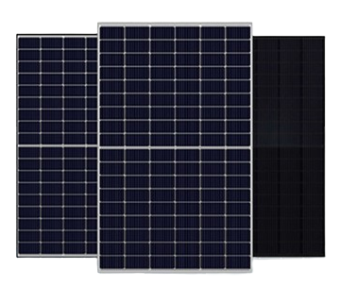









Solar Module Manufacturer & Comprehensive EPC Solution Provider
Manufacturing of Bifacial N-Type TOPCon Solar PV Modules
(Range 560Watt to 600Watt)
Solar
PV Panel
Solar Pump Controller
Solar Water Pumping System
Solar AC/DC Pumps
Solar Inverter Charger
Solar Charger Controller
Solar Home System
Solar Lighting System
We Offer on :

Slide 2

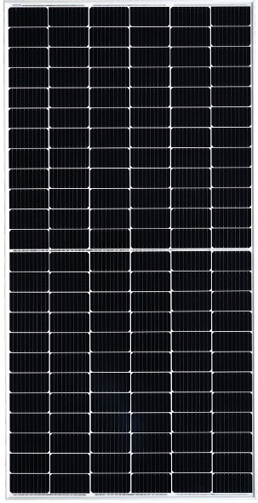



Topcon Bifacial 144 cells
Key Features
N-Type with Very Low LID
Resulting in higher power generation
Positive Tolerance
Power output with a positive tolerance.
Excellent performance in low light
Superior output in low irradiance Increased power production even in low-light environments.
Better Temperature coefficient (-0.30%/°C)
Higher power generation under higher ambient temperature conditions
Extended Wind and Snow load Tests
Certiﬁed to withstand: wind load (2400 Pascal) and snow load (5400 Pascal).
Higher <Module Efficiency
Module Efficiency Up-to 22.84%
10-30% more power generation
When compared with the P-type module
Advanced technology
MBB-Multi Bus- bar (16BB)
Half-cut N-TOPCon cell
Extended Wind and snow loads
Wind Load (2400 Pascal) and
Snow Load (5400 Pascal)
Withstanding a harsh environment
Reliable quality leads to better sustainability, even in harsh environment such as deserts, Farms, coastal and the areas with ammonia exposure
Rigorous testing criteria
100% I-V measurement, HiPOT test ans EL inspection, ensure defect-free modules
Bifaciality factor 80 ±5%
The ratio of the rear efficiency in relation to the front efficiency is subject to the same irradiance.
100%
98.00%
80.00%
84.8%
01
05
10
15
20
25

Slide 3
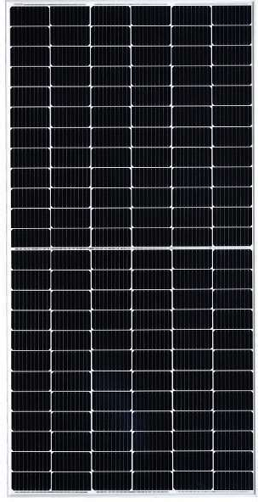
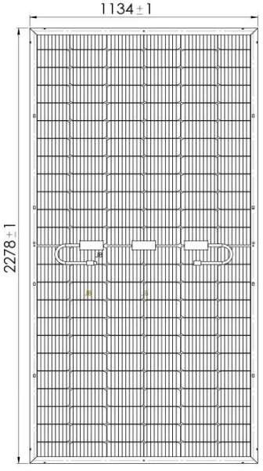
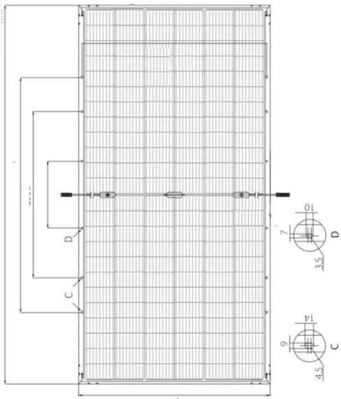
1096+/-1
2278+/-1
1400+/-1
1100+/-1
400+/-1
1134+/-1
Electrical Data Performance
Module Type |  | 560Wp | 570Wp | 580Wp | 590Wp | 600Wp
Conditions | Unit | STC | STC | STC | STC | STC
Peak Power, Pmax (Wp) | W | 560 | 570 | 580 | 590 | 600
Voltage at Maximum power, Vmp | V | 42.34 | 42.47 | 43.52 | 44.05 | 44.68
Current at maximum power, Imp | A | 12.98 | 12.85 | 13.33 | 13.38 | 13.43
Open circuit voltage, Voc | V | 50.14 | 52.39 | 51.19 | 51.24 | 51.29
Short circuit current, Isc | A | 13.55 | 14.03 | 14.06 | 14.26 | 14.46
Module Efﬁciency (%) |  | 21.98% | 22.08% | 22.45% | 22.84% | 23.22%
Operating Temperature ( 0C) | -40°C~+85°C |  | Temperature coefﬁcient of Isc (a) |  | -0.046%/°C
Maximum system voltage | 1500VDC |  | Nominal Operating cell temperature (NOCT) |  | 45±2°C
Maximum series fuse rating | 30A |  | Fire Safety |  | Class-C
Power tolerance (Wp) | 0~+3% |  | Application |  | Class-A
Temperature coefﬁcient of Pmax (γ) | -0.30%/°C |  | Safety Class |  | Class-II
Temperature coefﬁcient of Voc (ß) | -0.26%/°C |  | Temperature coefﬁcient of Isc (a) |  | -0.046%/°C
STC: Irradiance 1000W/m², module temperature 25°C, AM =1.5; NOCT: Irradiance 800W/m², ambient temperature 20°C, AM=1.5, wind Speed 1m/s. Average power reduction of 4.5% at 200W/m² as per IEC 60904- 1. Except Pmax, all other parameters have tolerance of +/-5%, measurement uncertainty +/-3%
BI-FACIAL OUTPUT - BACKSIDE POWER GAIN*
Bifacial Gain | Measurement | Unit | 560Wp | 570Wp | 580Wp | 590Wp | 600Wp
5% | Peak Power (Pmax) | W | 585 | 599 | 605 | 615 | 625
 | Module Efﬁciency | % | 22.64% | 23.21% | 23.42% | 23.80% | 24.19%
10% | Peak Power (Pmax) | W | 610 | 627 | 630 | 640 | 650
 | Module Efﬁciency | % | 23.61% | 24.29% | 24.39% | 24.77% | 25.16%
15% | Peak Power (Pmax) | W | 635 | - | 655 | 665 | 675
 | Module Efﬁciency | % | 24.58% | - | 25.35% | 25.74% | 26.13%
*Power gain from the rear side depends on the ground reﬂectance (Albedo) & Bifaciality factor.
I-V Characteristics At Different Irradiations
Module Mechanical Data
PV module : HimSol- 144 Cell”
SPECIFICATION DATA
Cells temp. = 25ºC
Cell Technology N- Type TOPCon, 182x91mm-MBB|144Cells
Dimensions (LxWxH) 2278X1134X35 mm
Incident Irrad. = 1000 W/m²
590.1W
Weight 28.00 kgs ± 1.5 kg
Incident Irrad. = 800 W/m²
465.2W
Superstrate 3.2mm High Transmission, Low Iron, Tempered Glass, AR coated
Rear Cover Substrate 2.00 mm Toughened Low Iron Glass/Transparent Backsheet
Incident Irrad. = 600 W/m²
348.9W
Frame Silver Anodized Aluminium frame with twin profile
Current (A)
Junction Box IP68, Spilit Junction box with individual Bypass Diodes
Incident Irrad. = 400 W/m²
231.5W
Cable & Connectors 300mmx2nos solar cable, 4mm2,MC4 Compatible Connectors IEC/UL certified
Application Class Class A (Safety Class II)
Mechanical Load Test 5400 Pa (Snow load), 2400 Pa (Wind load)
Incident Irrad. = 200 W/m²
113.8W
Standard Packaging 28 pieces/ Pallet
Per Container.
The speciﬁcations included in this datasheet are subject to change without notice.
The electrical data given here is for reference purpose only.
Please conﬁrm your exact requirements with the sales representative while placing your order.
Refer installation Manual instructions & Himalayan Solar warranty statement for terms & conditions
Voltage (V)

Slide 4
Solar Module Manufacture
Our Commitments
Quality Products & Solutions
Timely Delivery
Cost Effectiveness
Total Customer Satisfaction
Reach Us At:
Website: www.himalayansolar.co.in
Email: Info@himalayansolar.co.in
Phone: 917027794863
Landline: 1733258099
Manufacturing Unit:
Plot no- 237, HSIIDC Industrial Estate, Alipur, Barwala, Panchkula – 134118, Haryana, India

